Slide 1
Nutrient Profile Clustering
Laurel Meke
Nate Lauffenburger
Xinjin Li
Mariam Garcia
Sara Delawalla
Notes:
what was the problem you were trying to solve/tool you were trying to build?
how far did you get? (show us some code/results/repo/figures!)
what new things did you learn?
what was most challenging/rewarding about working on the project?
what aspects will you keep working on?

Slide 2
The Problem
We aimed to:
Identify clusters in the distribution of nutrients across a certain location
Identify clusters in the distribution of nutrients from mid depth to surface level waters
Identify patterns between the clusters of nutrients, concentrations of chlorophyll, and species of phytoplankton present
Tie in any connection between the nutrient profiles to chlorophyll’s depth profile
Data: https://simonscmap.com/catalog/datasets/HOT_Bottle_ALOHA
Notes:
We used a unique key to load in the data.
We also wanted to make sure that chlorophyll’s data came from the same dataset, as there is another file on here, however, it was sampled differently and we want to make sure that our analysis was as consistent as possible.

Slide 3
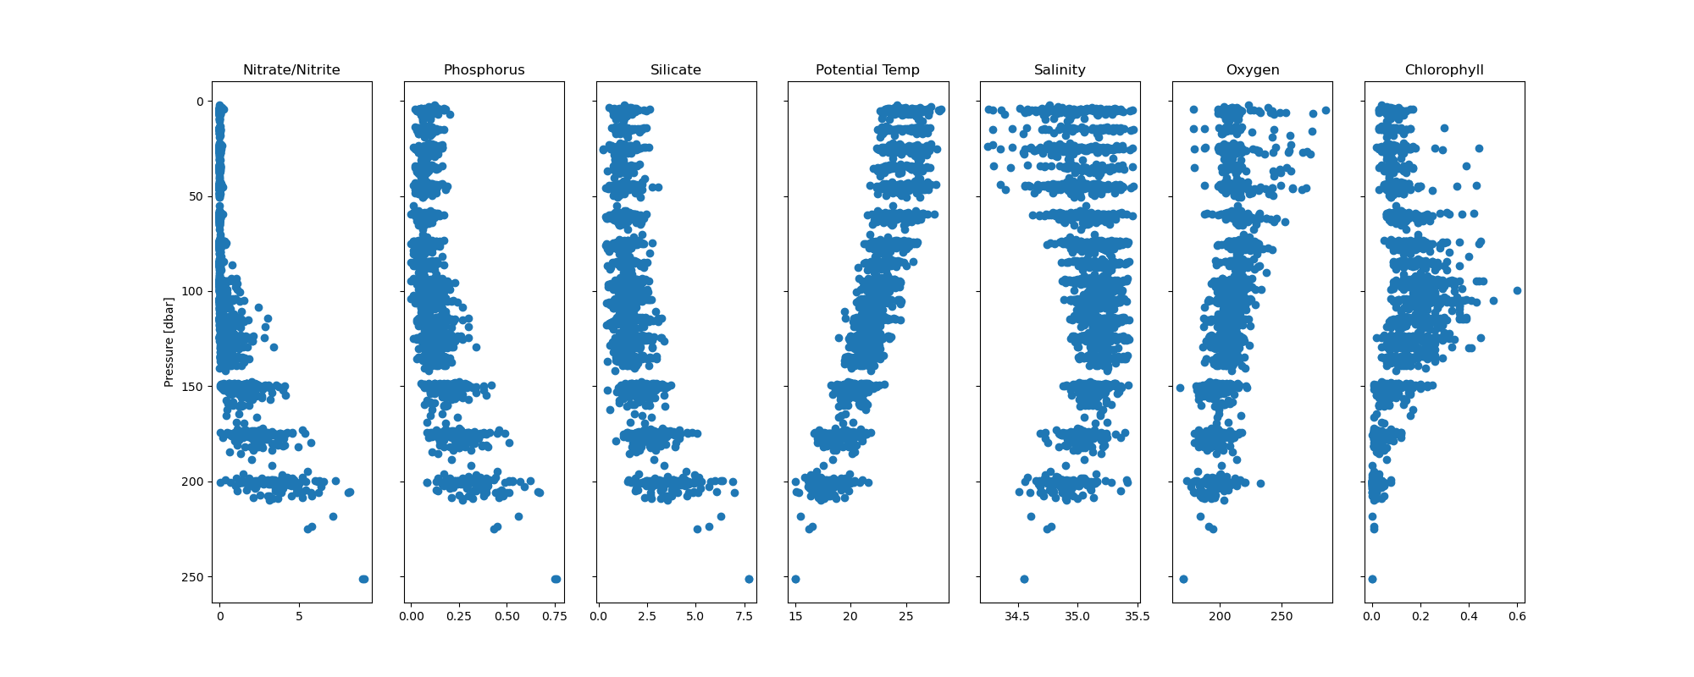
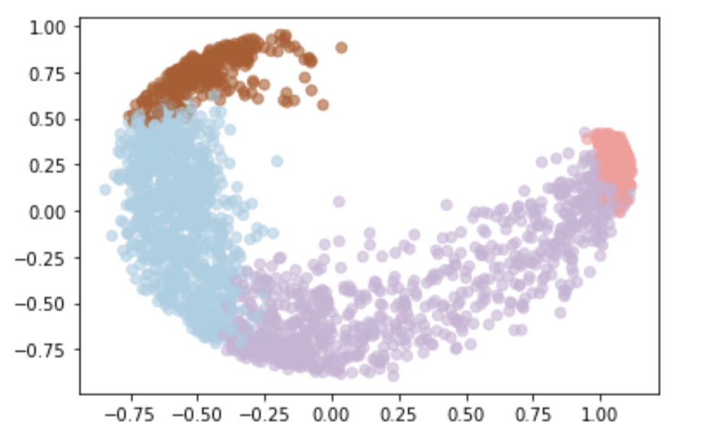
Our Progress…
Data Pre-processing
Subset
Nutrients vs. Depth
Dimension Reduction [PCA]
Clustering Analysis [Gaussian Mixture Model / KMeans]
Data Visualization
T-SNE (T-distributed Stochastic Neighbor Embedding)
Chlorophyll vs. cluster labels
Supervised Learning
Notes:
Now I’d like to talk about the overall progress in our project.
As introduced in the previous slide, we notice that most nutrients are concentrated on the surface layer, so we subset the dataset with depth less than 300 meters. It has around 2000 measurement right now, even much smaller than the HOT dataset.
Then, we did Principal Component Analysis to reduce the dimension, it simplified the complexity of computation but keep the trends and features. The plot here is the result of visualizing first and second PC, with number of components = 4.

Slide 4
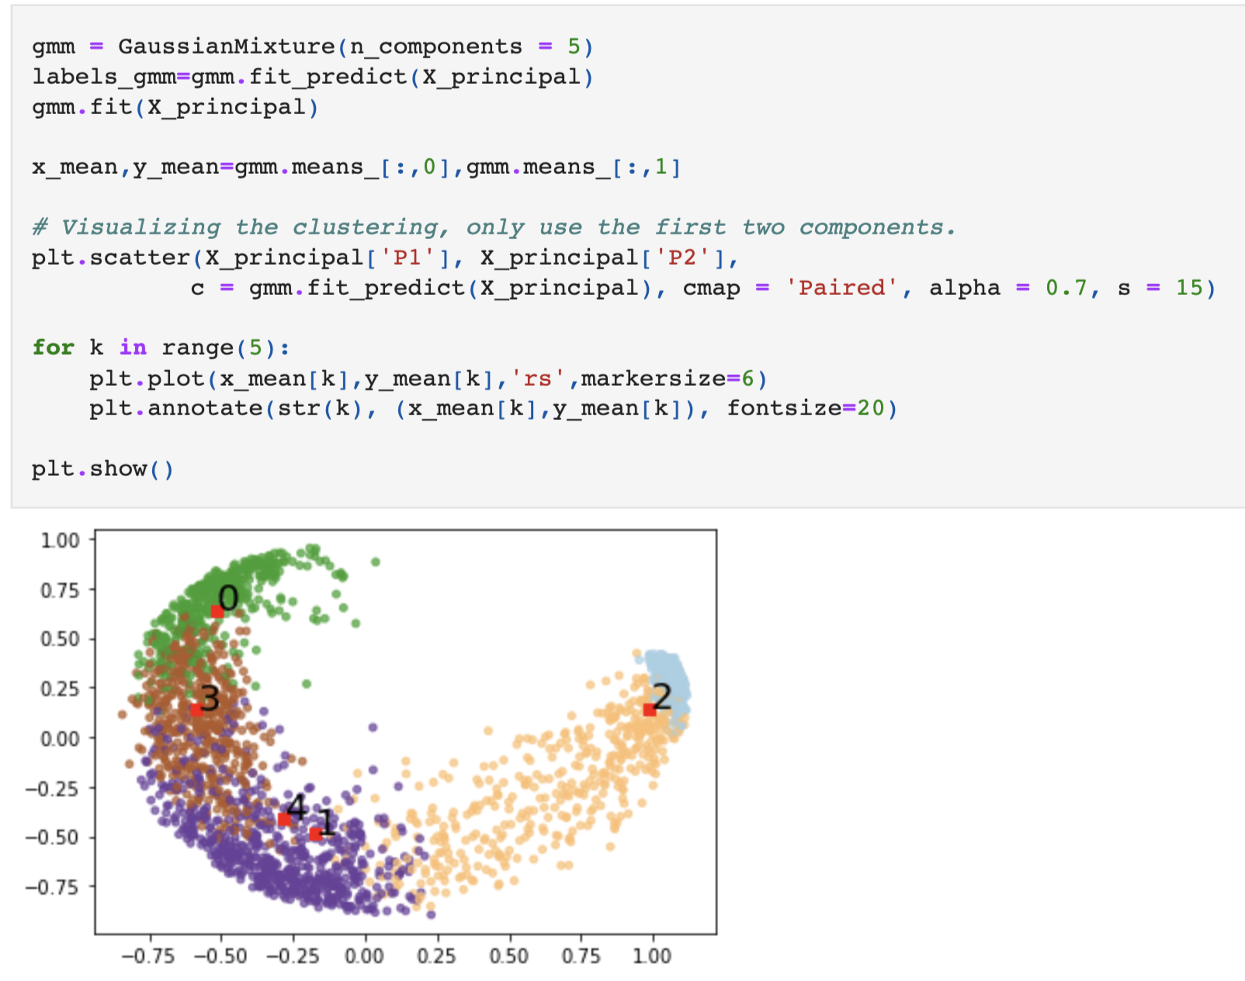
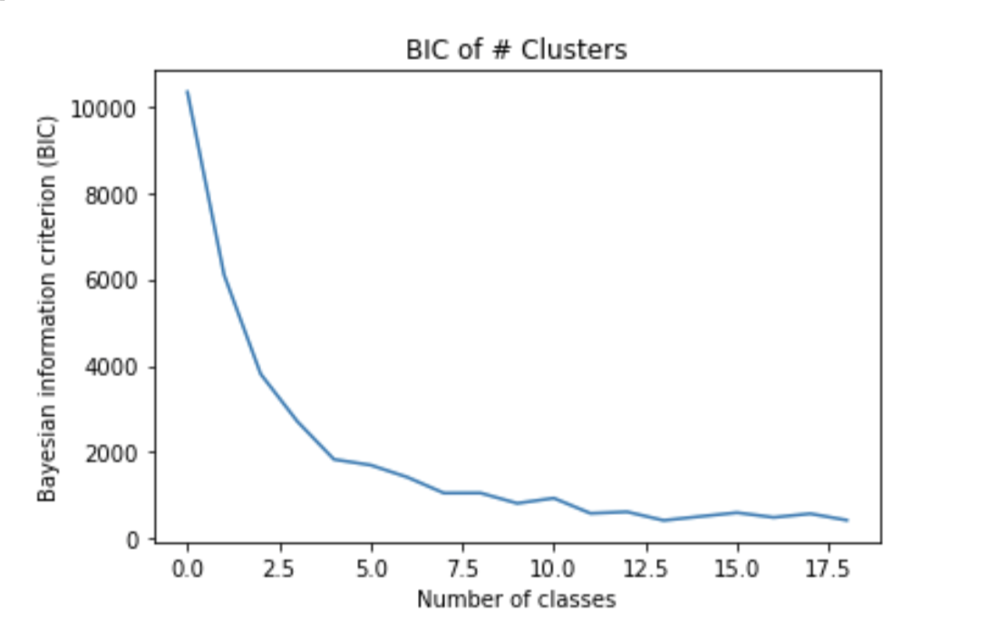
Our Progress…
Data Pre-processing
Subset
Nutrients vs. Depth
Dimension Reduction [PCA]
Clustering Analysis [Gaussian Mixture Model / KMeans]
Data Visualization
T-SNE (T-distributed Stochastic Neighbor Embedding)
Chlorophyll vs. cluster labels
Supervised Learning

Slide 5
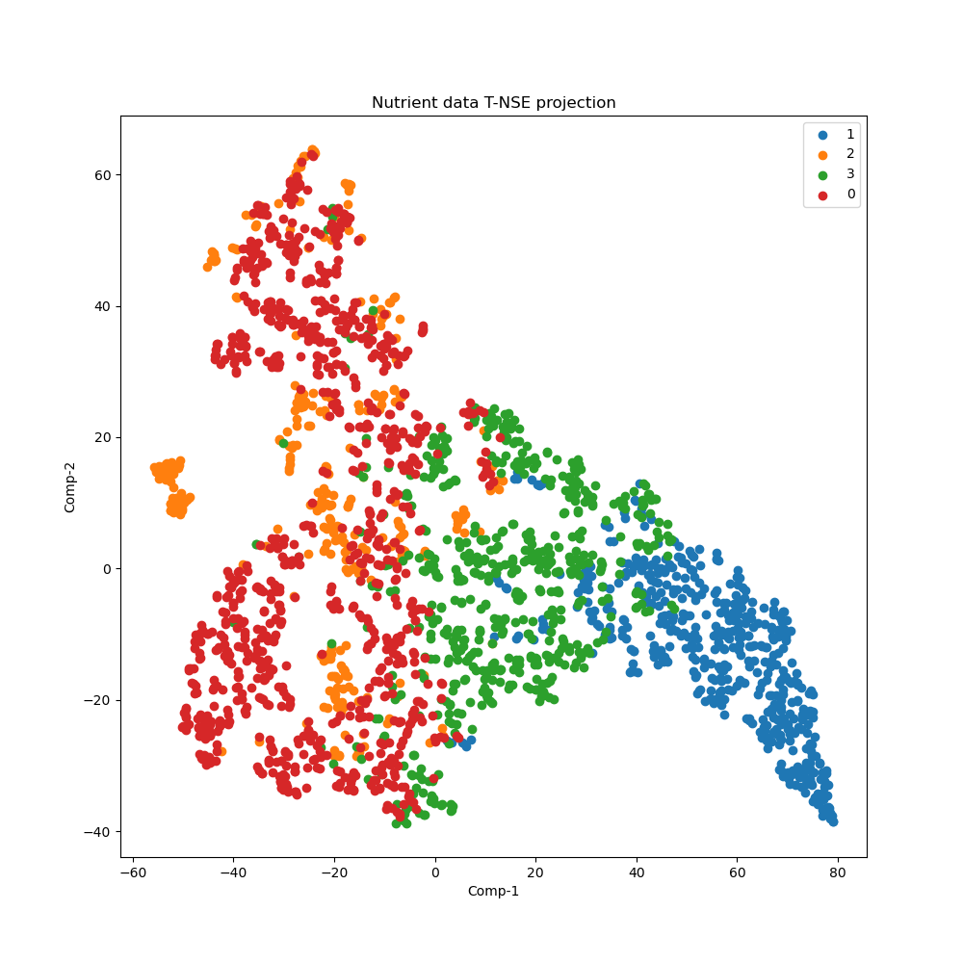
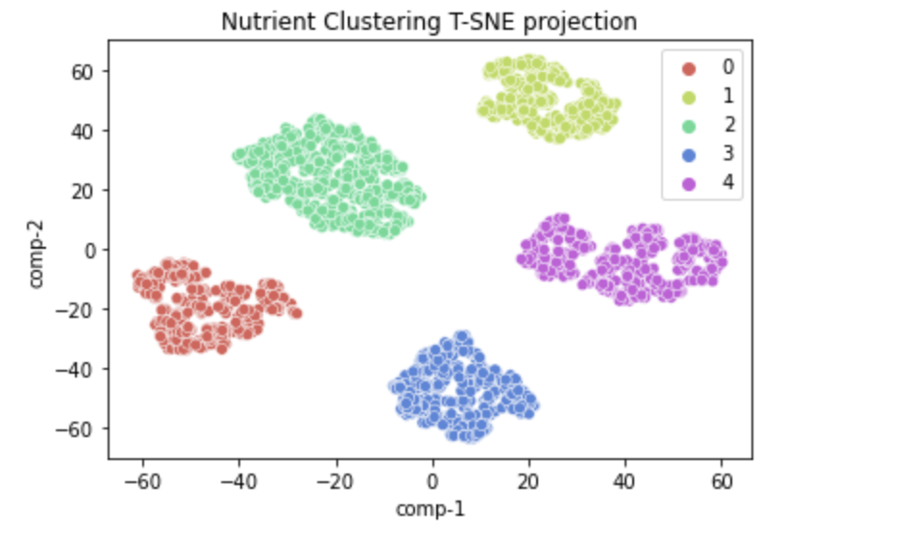
Visualizing high dimensional data in two dimensions
using tSNE (T-distributed Stochastic Neighbourhood Embedding)
Comparing GMM results
After PCA
From “Raw” Data
Notes:
t-SNE introduction to audience if needed.
t-SNE [1] is a tool to visualize high-dimensional data. It converts similarities between data points to joint probabilities and tries to minimize the Kullback-Leibler divergence between the joint probabilities of the low-dimensional embedding and the high-dimensional data. t-SNE has a cost function that is not convex, i.e. with different initializations we can get different results.
It is highly recommended to use another dimensionality reduction method (e.g. PCA for dense data or TruncatedSVD for sparse data) to reduce the number of dimensions to a reasonable amount (e.g. 50) if the number of features is very high. This will suppress some noise and speed up the computation of pairwise distances between samples.

Slide 6
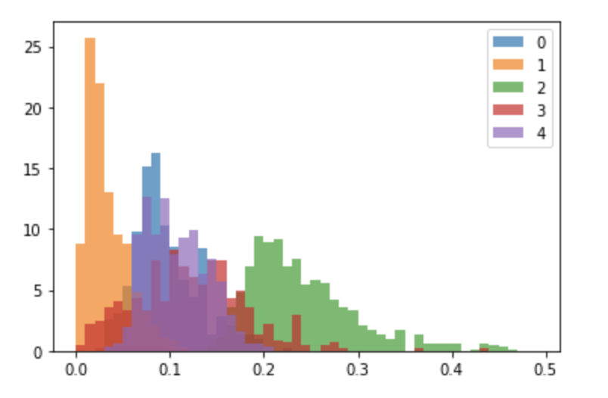
Our Progress…
Data Pre-processing
Subset
Nutrients vs. Depth
Dimension Reduction [PCA]
Clustering Analysis [Gaussian Mixture Model / KMeans]
Data Visualization
T-SNE (T-distributed Stochastic Neighbor Embedding)
Chlorophyll vs. cluster labels
Supervised Learning

Slide 7
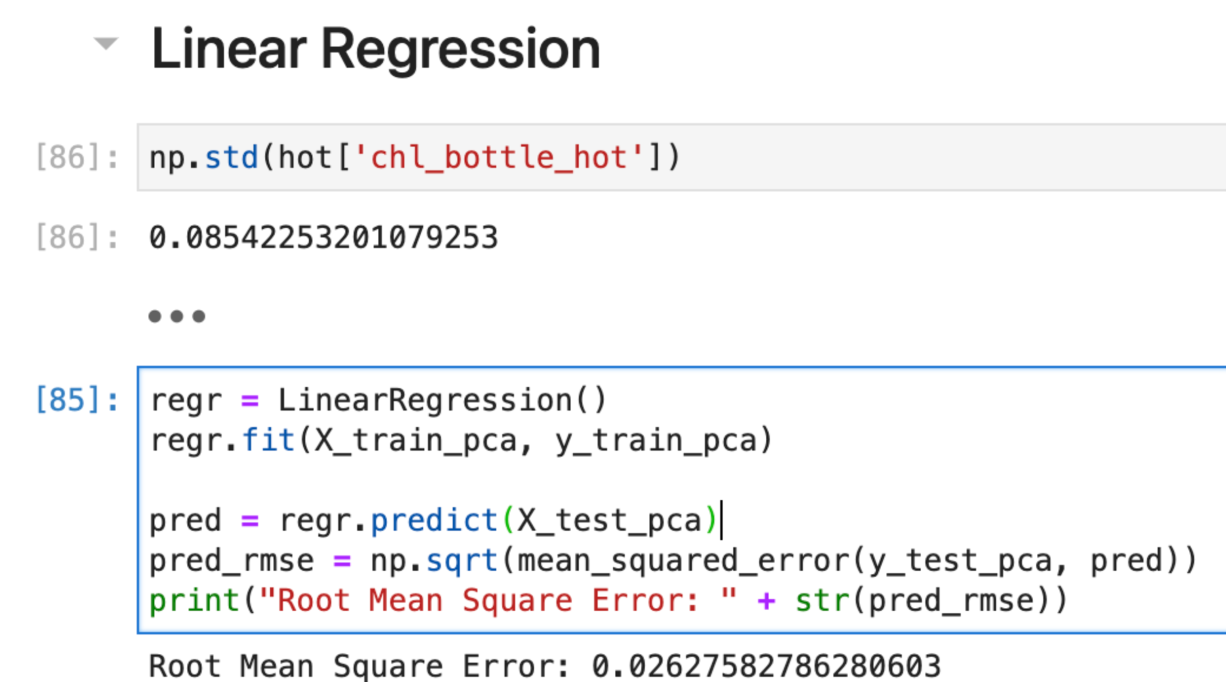
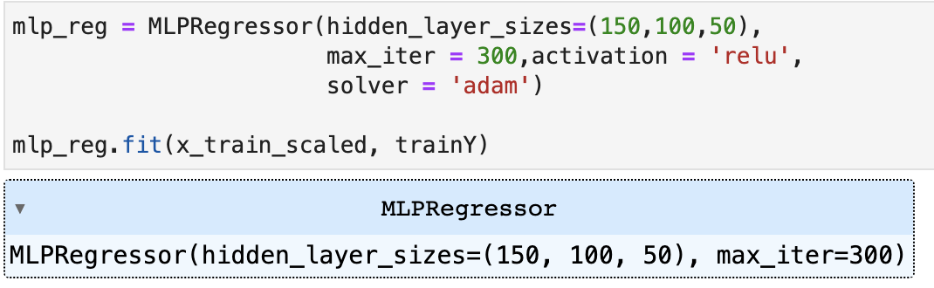
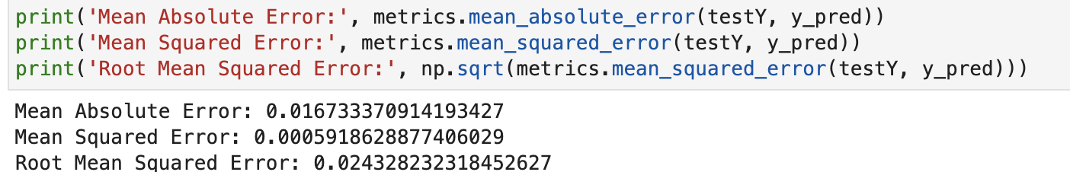
Our Progress…
Data Pre-processing
Subset
Nutrients vs. Depth
Dimension Reduction [PCA]
Clustering Analysis [Gaussian Mixture Model / KMeans]
Data Visualization
T-SNE (T-distributed Stochastic Neighbor Embedding)
Chlorophyll vs. cluster labels
Supervised Learning
Notes:
Final step we achieved at OceanHackWeek (supervised learning).
We did not make much progress here. The criteria we choose is the RMSE < the standard deviation of chl

Slide 8
Takeaways
What new things did we learn?
Biological oceanography knowledge from Bottle Data of Hawaii Ocean Time-series (HOT)
Machine learning algorithms implementation
Learning the meaning behind TSNE, how to push a Jupyter notebook onto Github!
What was most challenging/rewarding about working on the project?
Task workflow
Unfamiliarity with machine learning, the significance behind PCA, and other data analysis tools used
Team collaboration
What aspects will we keep working on?
Find biological species that correlated with the identified nutrient clusters
And more…
Notes:
We still have next steps, we may try to see if there are any particular biological species that correlate with the identified nutrient clusters

Slide 9
Thank you!
Questions? Comments?

